Slide 1
Fitness Dependent Optimizer: Inspired by the Bee Swarming Reproductive Process
Author Names:
1. JAZA MAHMOOD ABDULLAH
2. TARIK AHMED RASHID
Guided By:
Mr. B. Srinivasan, B.E., M.Tech.,
School of Computing, AP-III, IT, SASTRA University
srinivasan@core.sastra.edu
Published in IEEE Access ( Volume: 7 )
Date of Publication: 22 March 2019
Publisher: IEEE
DOI: 10.1109/ACCESS.2019.2907012
Scopus Index: 21100374601
Mini-Project Members:
1. Preethi T (121015078)
preethitamilvendan@gmail.com
2. Raghunathan MS (121015081)
bargav32@gmail.com
3. Surya Narayanan S (121015098)
suryan0800@gmail.com

Slide 2
Index
Methodology
Discussion on Algorithms
Results obtained
Interpreted result
Conclusion

Slide 3
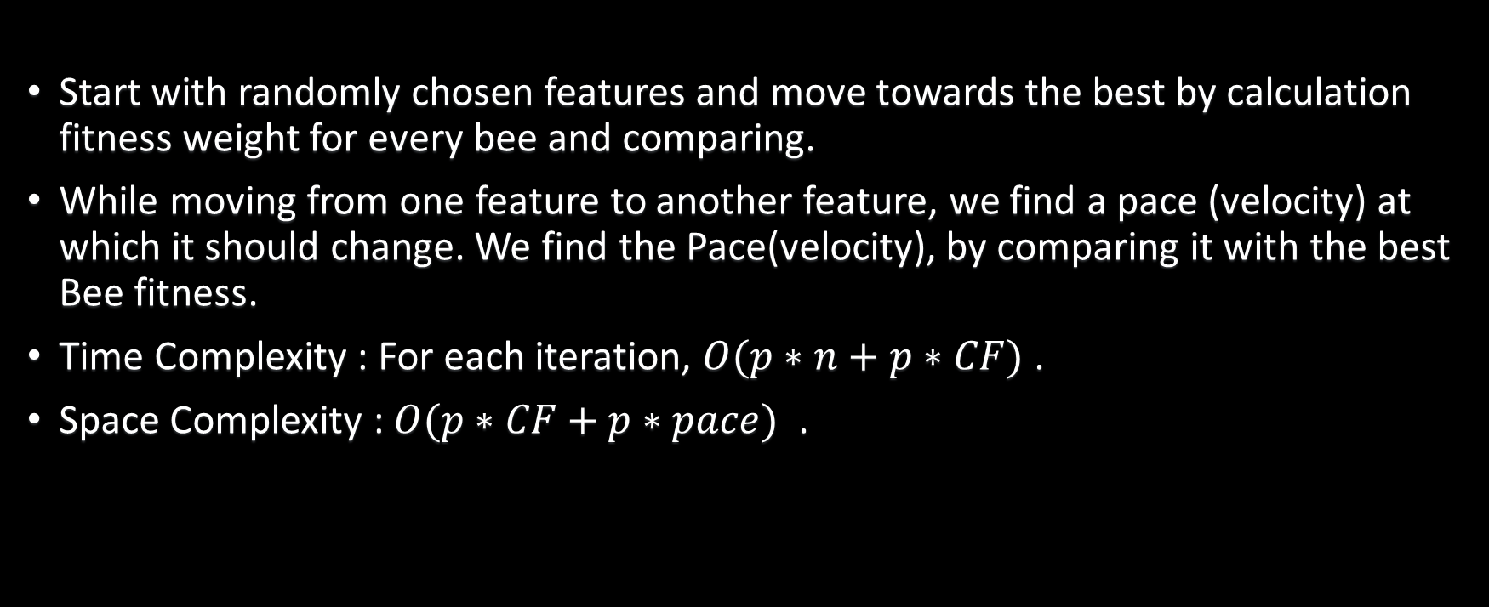
FDO Algorithm
Start with randomly chosen features and move towards the best by calculation fitness weight for every bee and comparing.
While moving from one feature to another feature, we find a pace (velocity) at which it should change. We find the Pace(velocity), by comparing it with the best Bee fitness.
Time Complexity : For each iteration, $O(p∗n+p∗CF)$ .
Space Complexity : $O(p∗CF+p∗pace)$ .

Slide 4

FDO Formula
$x_{i}$(i= 1, 2, . . .p);
$x_{i,t+1}$= $x_{i,t}$+ pace
$fw=\left|\frac{x_{i,t fitness}^{∗}}{x_{i,t fitness}}\right|− wf$
$\left\{\begin{matrix}fw=1 or fw=0 or x_{i,t fitness}=0,pace= x_{i,t} ∗r \\ fw>0 and fw<1 \left\{\begin{matrix}r<0, pace= \left(x_{i,t} − x_{i,t}^{∗}\right) ∗fw ∗( − 1) \\ r≥0, pace= \left(x_{i,t} − x_{i,t}^{∗}\right) ∗fw \end{matrix}\right\}\end{matrix}\right\}$

Slide 5
Flow Chart
Select N random Points (feature set)(scout bees)
No
Find Best Points (Scout Bee) using fitness value
Yes
Still more points or still more iterations
Find Pace, new fw using Best Bee Fitness value
No
Yes
Update new Points using Pace
Yes
Yes
fw_{i, t+1} > fw_{i, t}
fw_{i, t+1} > fw_{i, t}
No
Yes
Using previous best Pace, find fw
Random Walk
No
fw_{i, t+1} > fw_{i, t}
Note : fw – Fitness Value, pace – how far the point is moved

Slide 6
Comparison with Genetic Algorithm
 | Fitness Dependent Optimizer | Genetic Algorithm
Procedure | Share Collective knowledge from Bees Move with the bee that most bees accept | Selection (select the fittest two individual) Crossover (exchanging the genes of parents) Mutation (some bits get flipped)
Time Complexity | More | Less
Accuracy | May find Global Optimum | May struck with local Optimum

Slide 7
Comparison with Dragonfly Algorithm
 | Fitness Dependent Optimizer | Dragonfly Algorithm
Weights used : | Fitness Weight (fw) Weight Factor (wf) | separation weight (s) (How distance is the dragonfly from other dragonflies), alignment weight (a) (average velocity direction of all other dragonflies), cohesion weight (c) (distance between average dragonfly and itself), food factor (f) (distance from best dragonfly and itself), enemy factor (e) (distance between worst dragonfly and itself), and inertia weight (weightage to take account of previous pace or velocity)
Algorithm Complexity | Less | High
Time Complexity | Comparably faster | Comparably slower
Accuracy | May converge at Global Optimum | stuck into local optima due to high exploitation rate.
Concentrates on | Only Best Fitness | Both Best Fitness and Worst Fitness

Slide 8
Comparison with Salp Swarm Algorithm
 | Fitness Dependent Algorithm | Salp Swarm Algorithm
Weights used | Fitness Weight (fw) Weight Factor (wf) | c1 (balances exploration and exploitation) (starts exploitation when it nears end iteration) c2 and c3 (determines direction)
Algorithm Complexity | Comparable | Comparable
Accuracy | May converge at Global Optimum | stagnating in local optima.
Coverage | Uses fitness weight to both explore and exploit | Uses c1 to explore and exploit which is calculated based on iteration, which is not good

Slide 9
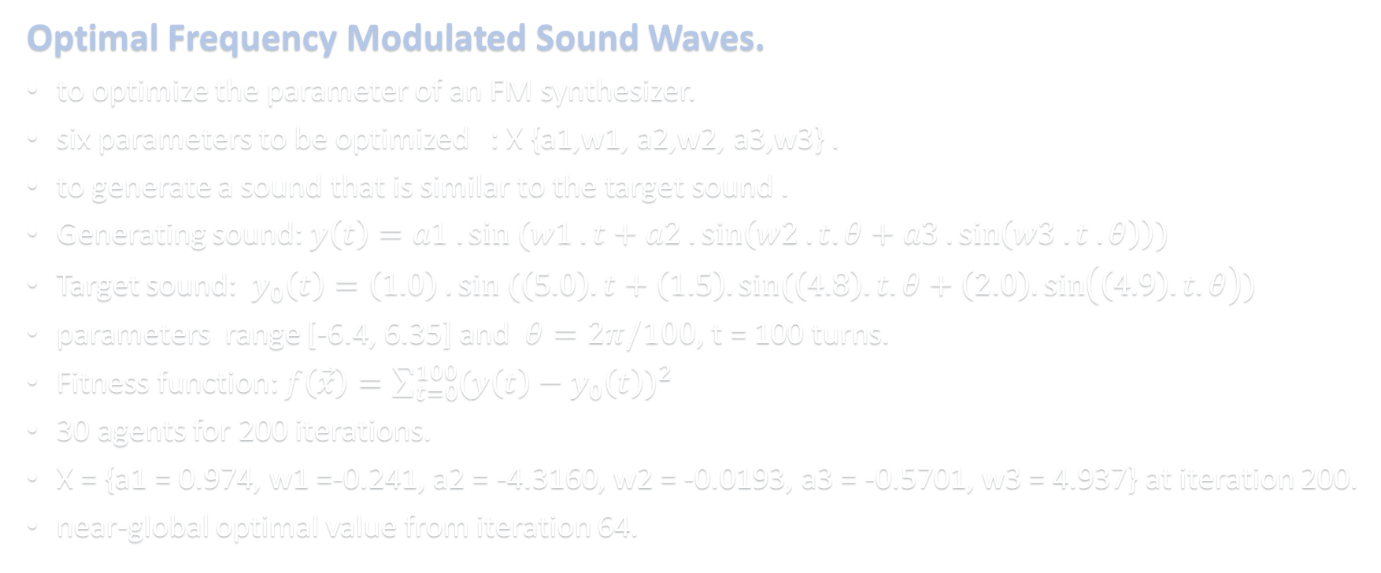
Application
Optimal Frequency Modulated Sound Waves.
to optimize the parameter of an FM synthesizer.
six parameters to be optimized : X {a1,w1, a2,w2, a3,w3} .
to generate a sound that is similar to the target sound .
Generating sound: $y\left(t\right)=a1 . sin (w1 . t+a2 .\sin\left(w2 . t. θ+a3 .\sin\left(w3 . t . θ\right)\right))$
Target sound: $y_{0}\left(t\right)=\left(1.0\right) . sin (\left(5.0\right).t+\left(1.5\right).sin(\left(4.8\right).t.θ+\left(2.0\right).\sin\left(\left(4.9\right).t.θ\right))$
parameters range [-6.4, 6.35] and $θ=2π/100$, t = 100 turns.
Fitness function: $f\left(\vec{x}\right)=\sum_{t=0}^{100}{{(y\left(t\right)−y_{0}\left(t\right))}^{2}}$
30 agents for 200 iterations.
X = {a1 = 0.974, w1 =-0.241, a2 = -4.3160, w2 = -0.0193, a3 = -0.5701, w3 = 4.937} at iteration 200.
near-global optimal value from iteration 64.

Slide 10
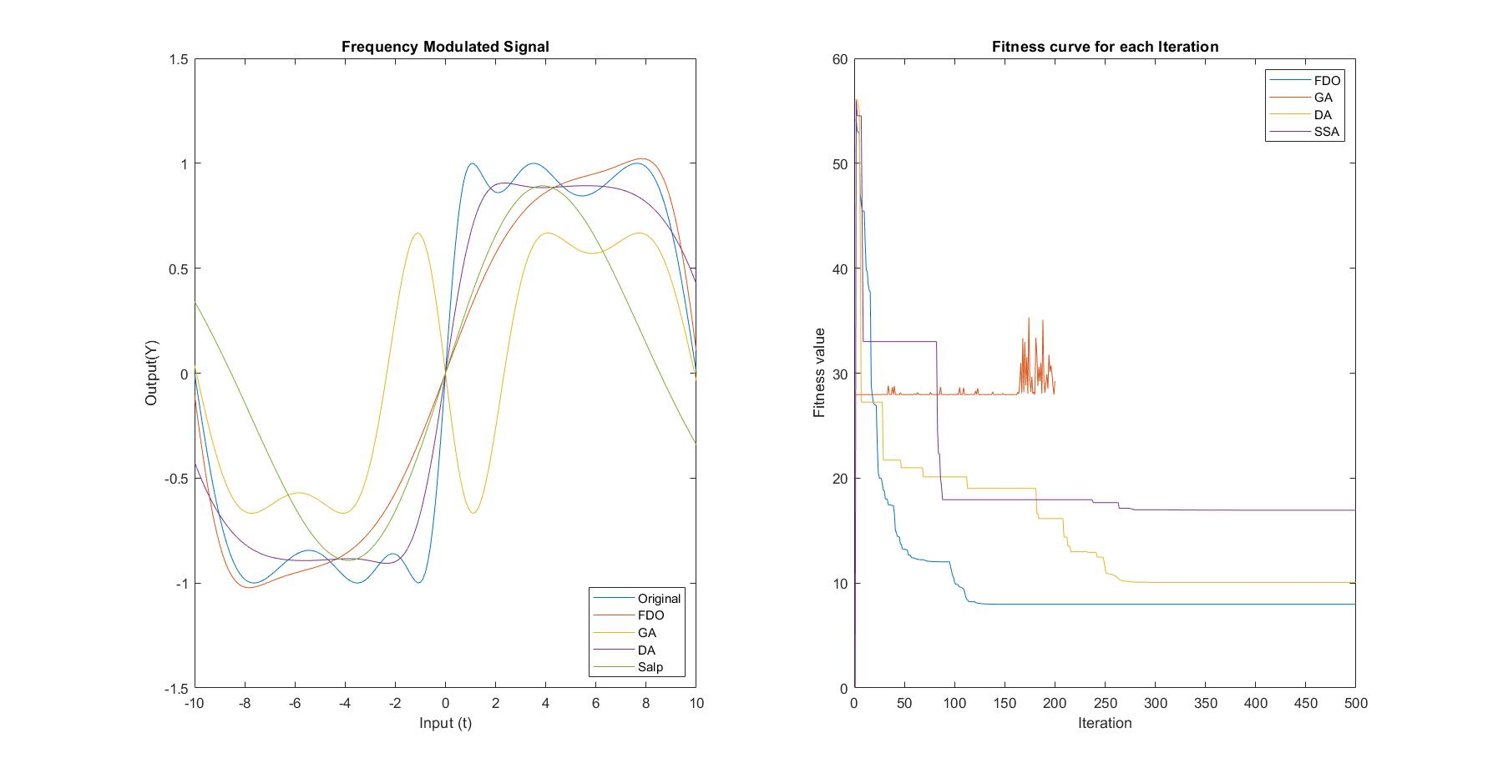
Result for Optimal FM Sound Waves

Slide 11
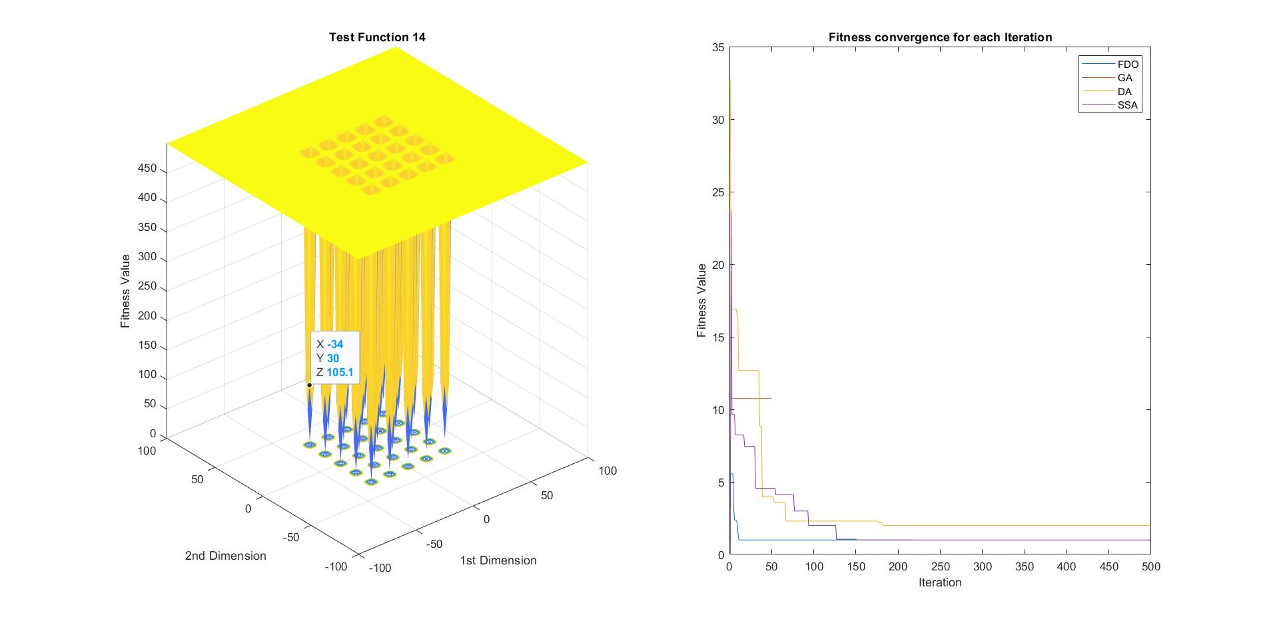
Result for Test Function 14

Slide 12
Conclusion
FDO performs better in most cases and comparable in other cases
Future Improvement:
Take Worst Fitness into account while calculating weights
Memory to store N Best Fit Points among all the iterations
Break when there is no much difference in best Fitness values to reduce time.

